Slide 1
Annual General Meeting 2015 - 16

Slide 2
Emma Latimer
Chief Officer

Slide 3
The story so far

Slide 4
Mental Health Children & Young People
CAMHS
Child and Adolescent
Mental Health Services
In July 2015
281
young people
were waiting to access CAMHS
120
had waited
longer
than
18 weeks
In April 2016
1
2
0
had waited longer than 18 weeks

Slide 5
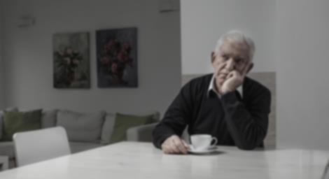
Mental Health Adults
Dementia
September 2015
We need
to diagnose
“
”
67%
of expected
cases in Hull

Slide 6
Mental Health Adults
Dementia
September 2016
We need
to diagnose
We diagnosed
67%
77.3%
of expected
cases in Hull

Slide 7
Mental Health Adults
Dementia
By March 2017
We
diagnosed
The National Target
will
80%
66.7%
77.3%
of expected
cases in Hull

Slide 8
Mental Health Adults
Lets Talk
September 2015
The service
will help
“
”
6000
people in Hull

Slide 9
Mental Health Adults
Lets Talk
April 2015 - March 2016
The service
will help
The service
helped
5997
6000
people in Hull

Slide 10
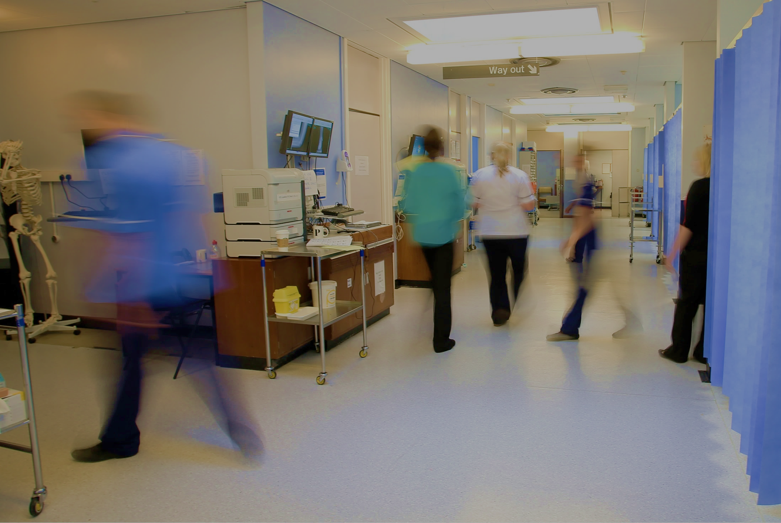
Hospital Services
Referral to Treatment
National Target
September 2015
September 2016
91%
92%
88%
of
Patients
Of Patients
Were treated
within 18 weeks
should be
treated
within
18 weeks

Slide 11
Hospital Services
A&E
April- August 2016
National Target
July 2015
80%
95%
84.3%
of patients
were seen
within 4 hours
of
Patients
should be
seen
within
4 Hours

Slide 12
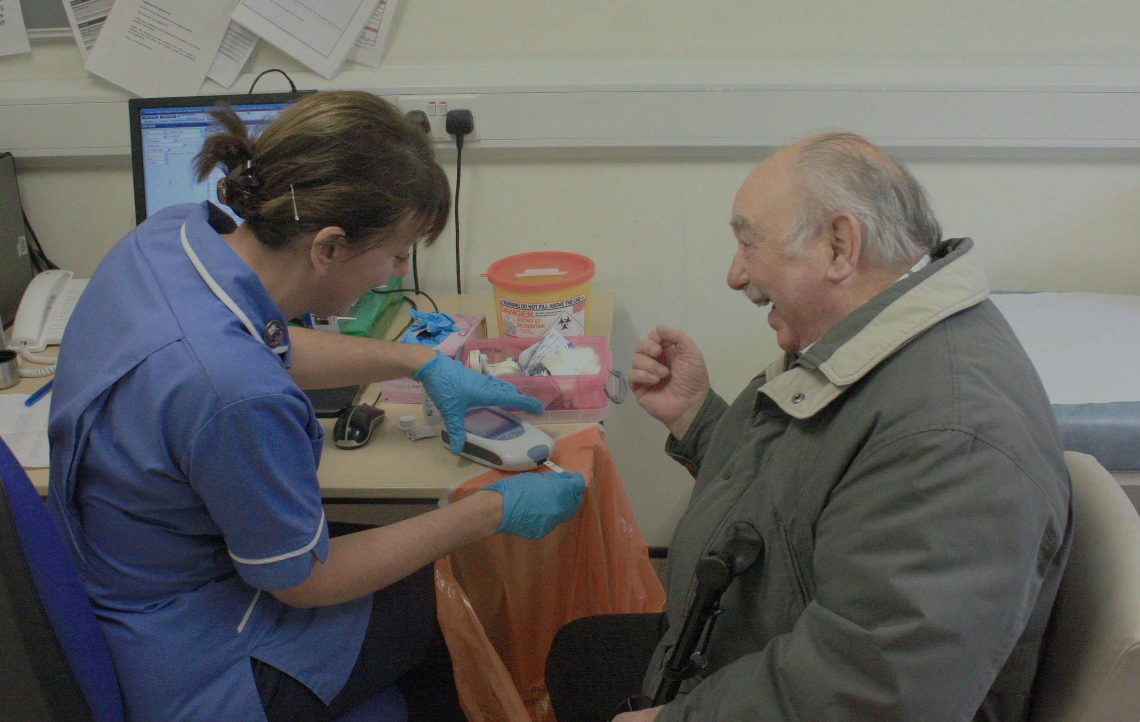
Primary Care
45%
By 2020
of GPs working in Hull could have
recruitment
and
retention
Since 2007/8
Health policy is moving towards
There is an
increase
in number
General Practice
of
retired
is an issue
clinical staff,
including
GPs,
GP Practices
20%
of
being
open longer hours
complex patients
is under
and at
requiring
weekends
hospital tests
Increasing Pressure
falling
numbers of GPs
in training are
12%
and
Only
care co-ordination
with many
training places unfilled
Rise in demand
Of Hull GPs are under
40 years

Slide 13
The next chapter

Slide 14
The Next Chapter Hull CCG

Slide 15
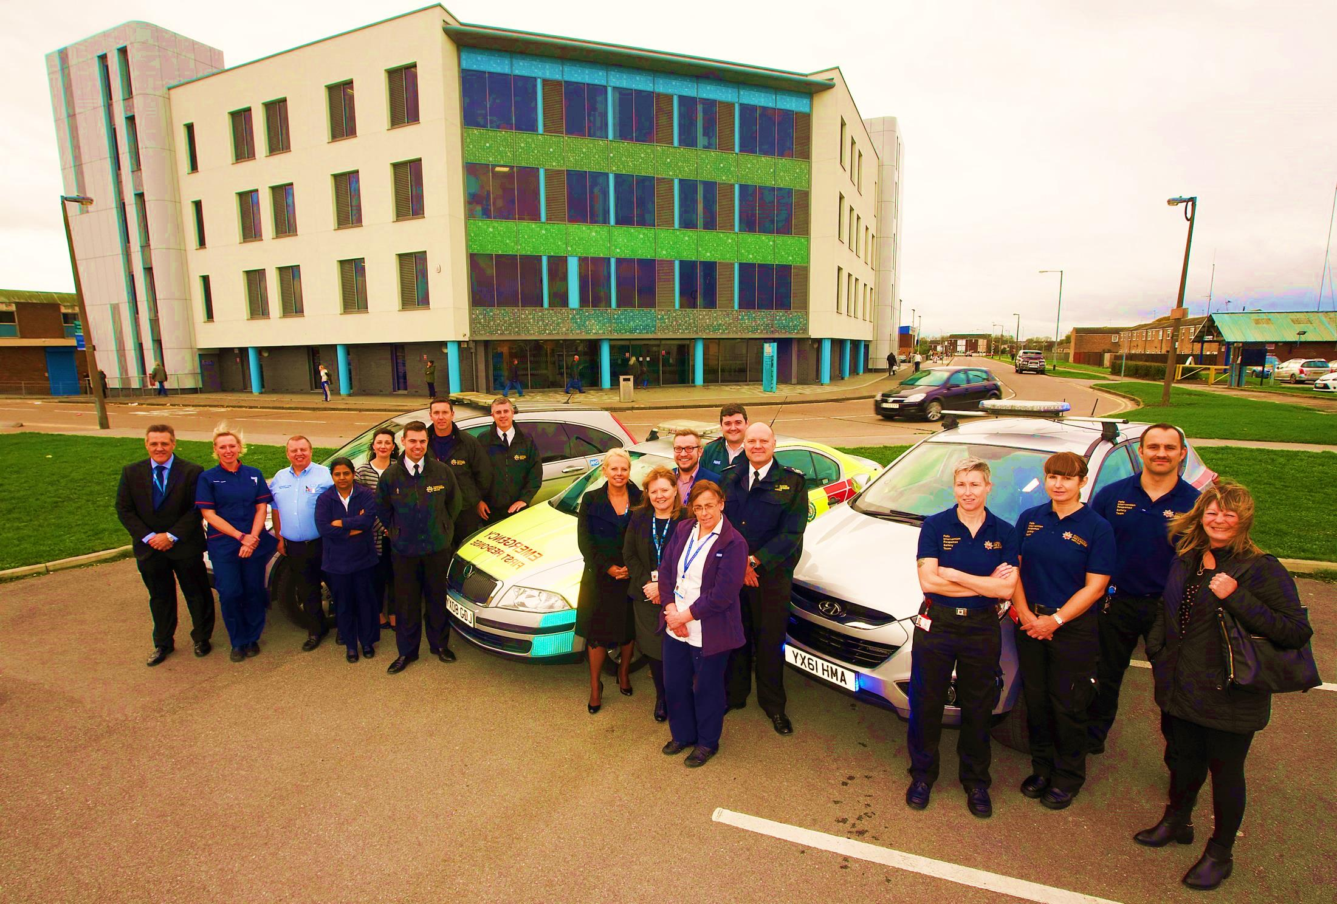
The Next Chapter Hull 2020
Falls Team

Slide 16
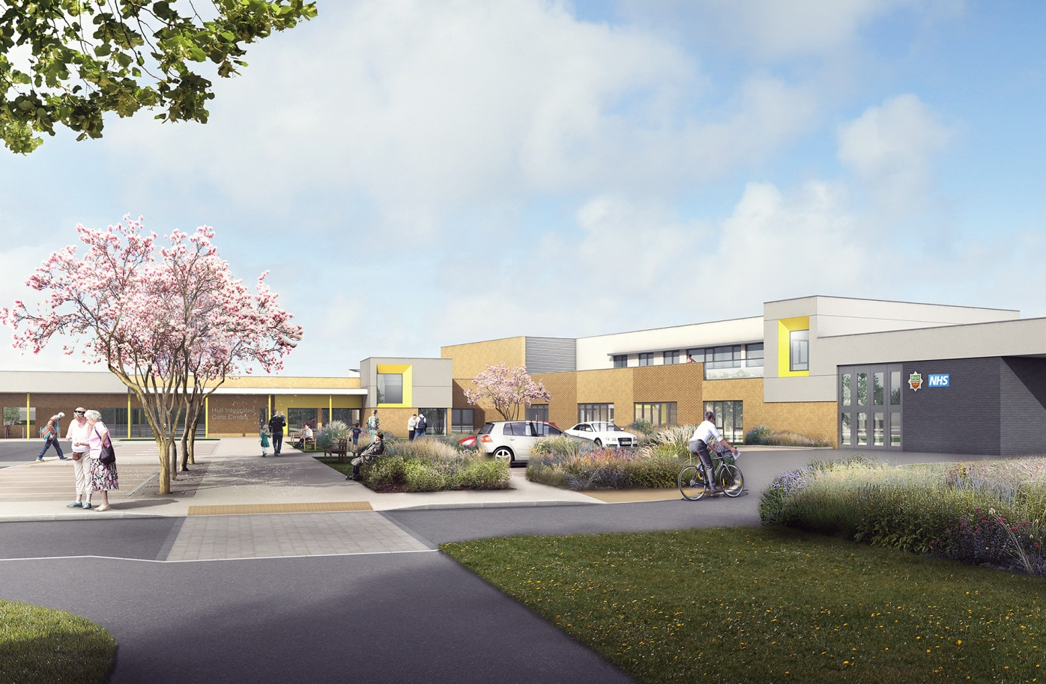
The next chapter
The Next Chapter Hull 2020
Integrated Care

Slide 17
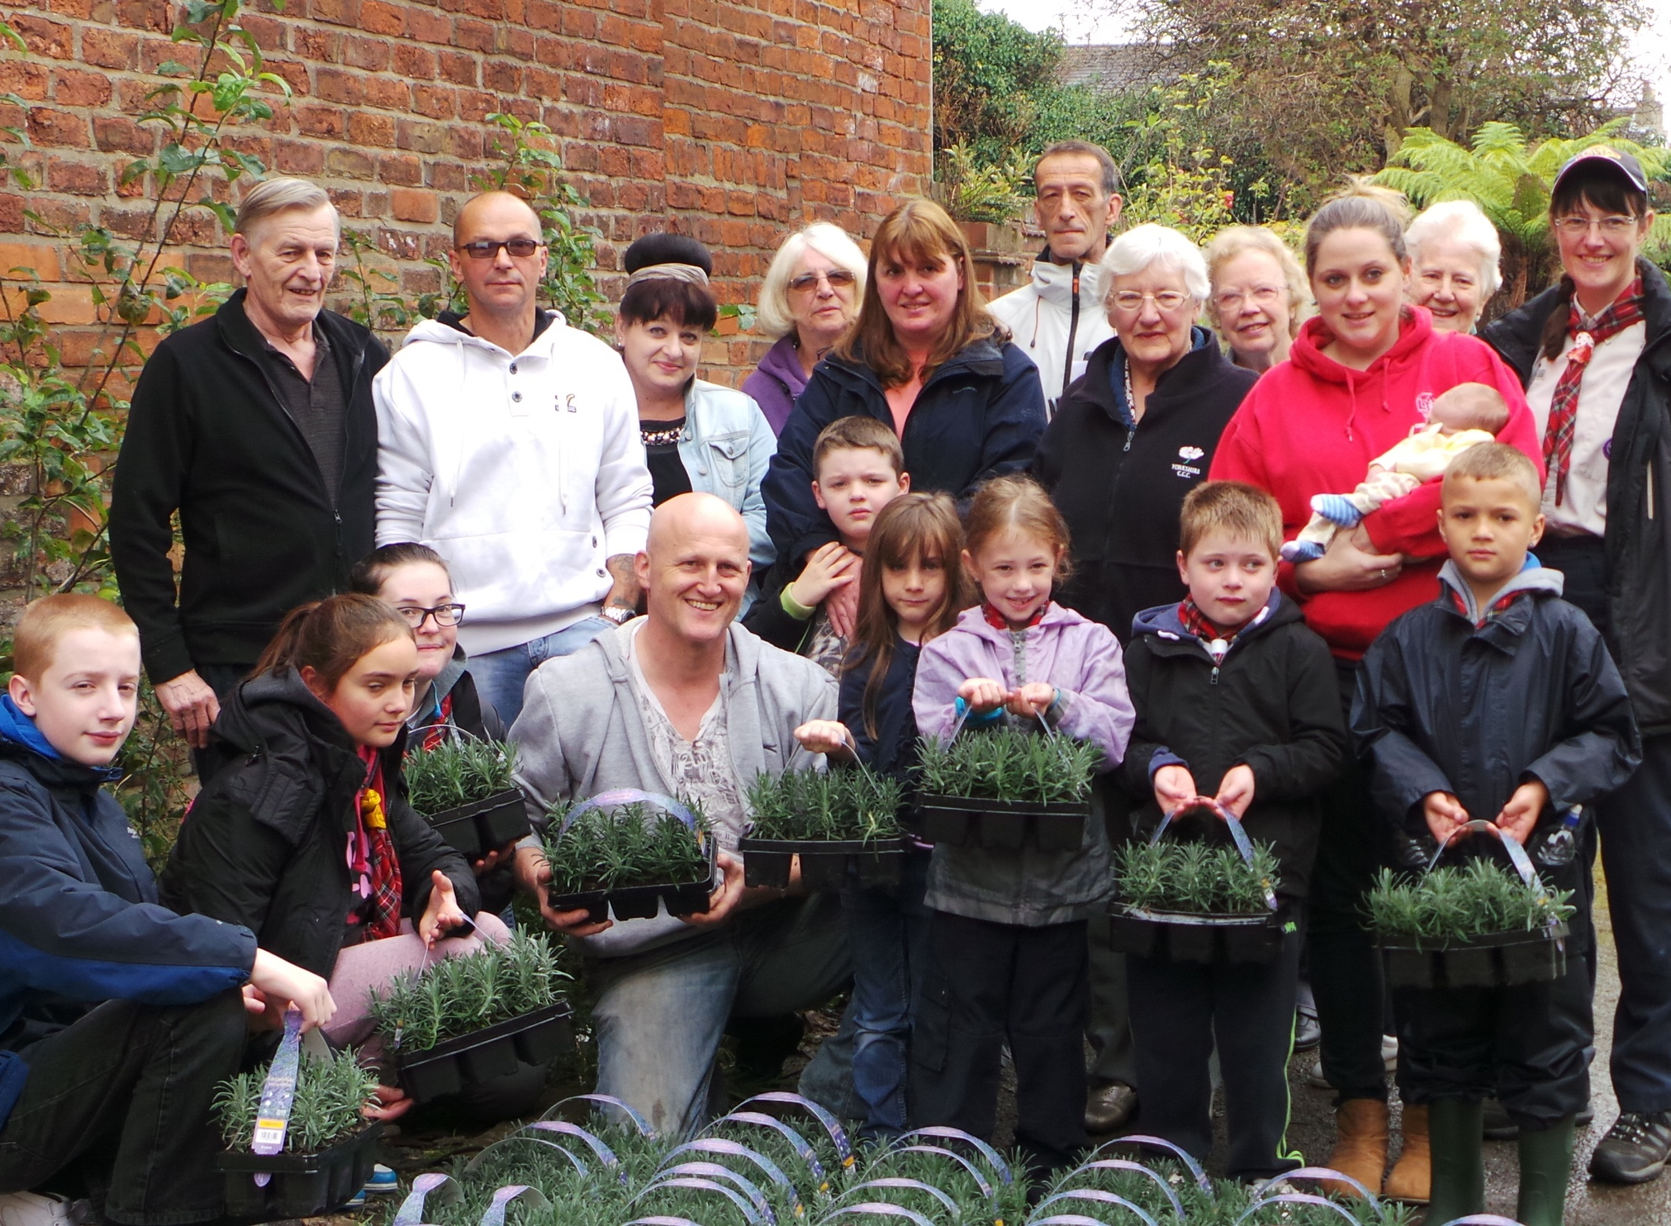
The Next Chapter Hull 2020
Champions on every street

Slide 18
The Next Chapter STP
Working
together

Slide 19
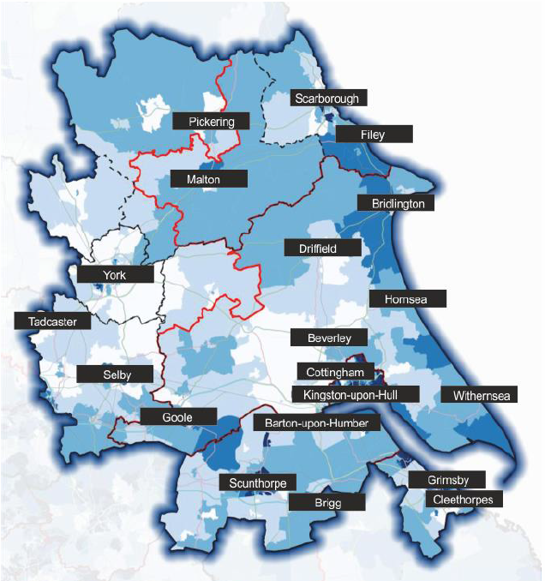
to close the
Health &
Wellbeing
gap
financial
quality
and
improve
outcomes
In
our region

Slide 20
2015/16 Highlights

Slide 21
Annual General Meeting 2015 - 16

