Slide 1
Annual General Meeting 2015 - 16

Slide 2
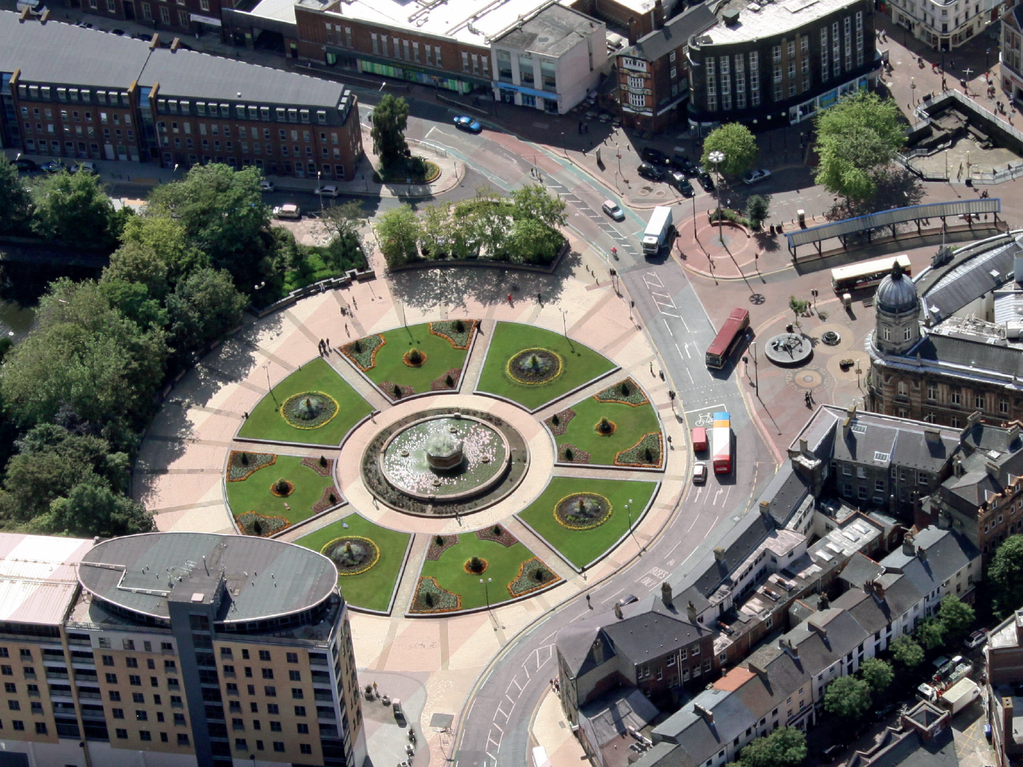
Emma Latimer
Chief Officer

Slide 3
Dr Dan Roper
Chairman

Slide 4
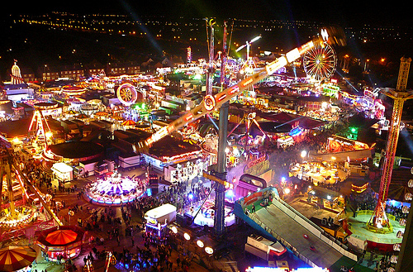
Emma Sayner
Chief Finance Officer

Slide 5
How we spend the CCG’s money
Last year
Grand total: £389.2 m
Notes:
Hospitals 2% less
Community Services increased 12.9 to 14.4%
Drugs 0.2% less

Slide 6
Achievement of financial targets
Running costs
Paying bills
Surplus
Audit
3rd year running
Audit signed
off with no recommendations
Achieved
£7.8m
2% surplus
Achieved
£6.2m spent,
£6.5m allocation
Achieved
Over 95% of invoices are
paid within
30 Days

Slide 7
What if the CCG were a car?

Slide 8
High performing
Large bills just around the corner
Reliable
Good reputation for quality
Expensive to run
Taken from
BMW 5 Series Product Trailer 2009

Slide 9
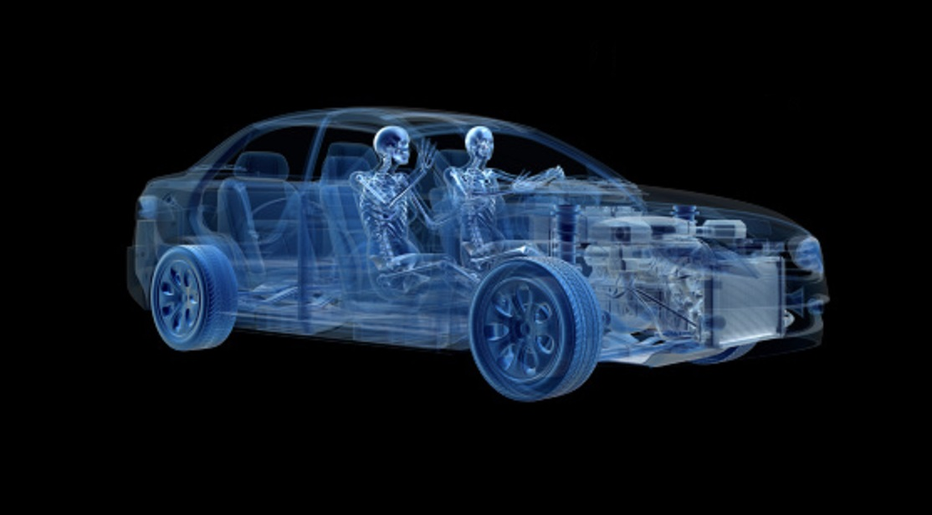
Fuel
Funding from Department of Health
Passenger
Patients
Sat Nav
Health Policy
e.g. 5 Year Forward View
Cost of healthcare
Journey Costs
Health providers
Engine
MOT
Audit
Cost of CCG running
Servicing
DVLA
NHS England, assurance review every 3 months, issues our licence

Slide 10
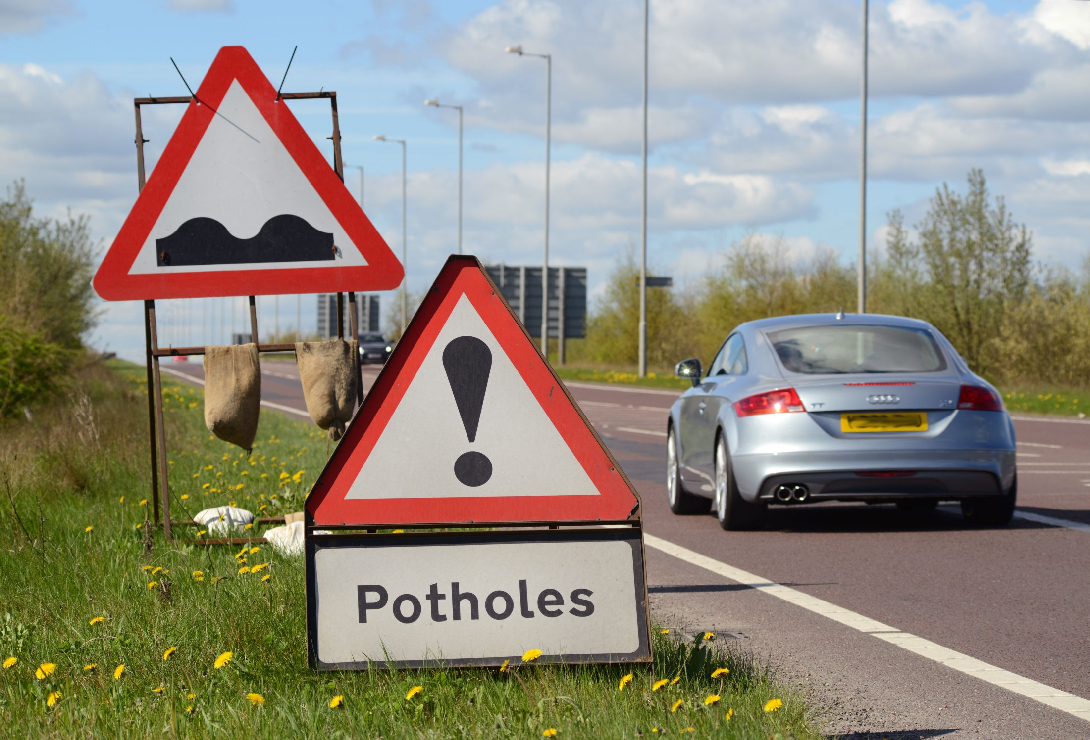
Potholes & speed bumps

Slide 11
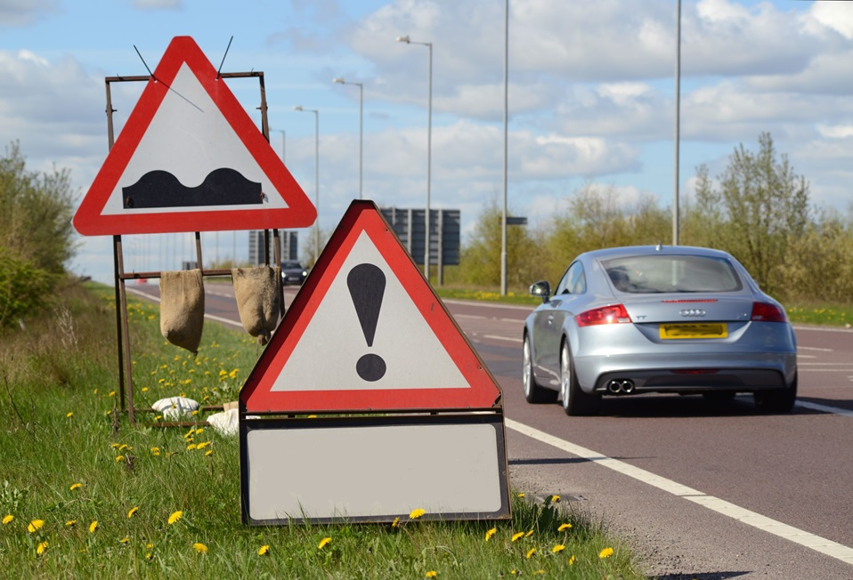
Potholes & speed bumps
Service Providers struggling across the NHS
Population health is poor compared to others
Reduced growth in NHS funding
Ageing GP population
Demand on Hospital Care increasing

Slide 12
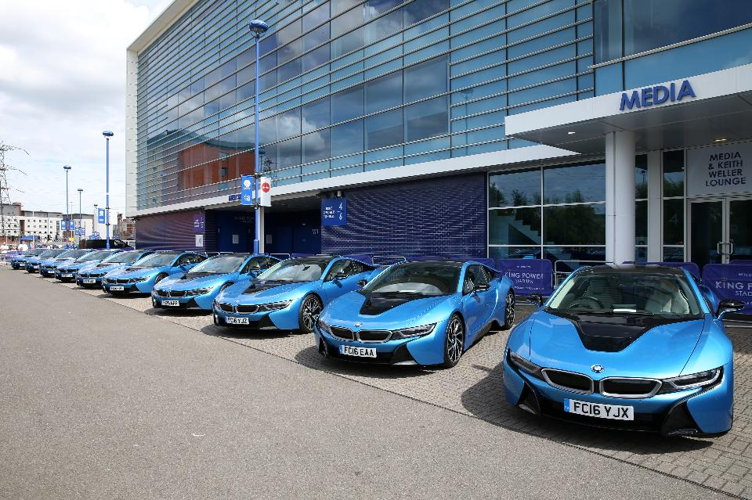
We need an upgrade
Humber
Coast & Vale
Strategic Transformation
Plan needs to be a fleet of BMW i8s
Working together
Engines using modern technology
High performing
Highly efficient

Slide 13
we have a long way to go
the road ahead is
bumpy
but
The CCG
has a good
financial track
record

Slide 14
Annual General Meeting 2015 - 16

